Slide 1

Understanding Search Engine Optimization (SEO)
Kubilay Cagatay
WEB 225

Slide 2

SEO Concepts
SEO stands for “search engine optimization.” In simple terms, it means the process of improving your site to increase its visibility for relevant searches. The better visibility your pages have in search results, the more likely you are to garner attention and attract prospective and existing customers to your business.

Slide 3

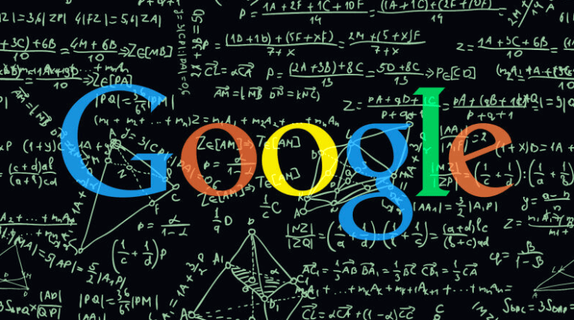
Secrets of Popularity
Google’s focus on creating relevant, user-focused content really is the key to its algorithm of scalable relevance.
Google is constantly trying to find ways to reward content that truly answers users’ questions and ways to minimize or filter out content built for content’s sake.
Hyperlinks are the most important factor when it comes to ranking web pages. This is the result of them being difficult to manipulate.
Modern search engines look at link profiles from many different perspectives and use those relationships to determine rank. The takeaway for you is that time spent earning links is time well spent.

Slide 4
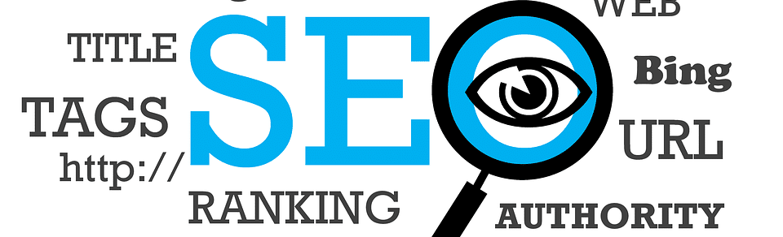
Secrets of Relevancy
If your website is trying to rank quickly for a specific topic, and yet there is not a piece of high-value content that addresses that topic, the probability of showing up in the Google search results is small.
To find these gaps in content and rankings there is a strategy called a Gap Analysis that is used by SEO strategists. This strategy takes an inventory of current content and keyword targets and then compares them to the keywords and topics the website is trying to rank for – which gives you the gap between expectations and reality.

Slide 5

1,000-foot view – Understanding the Neighborhood
You need to make sure you know where your website will stand in the context of the World Wide Web.
When viewing a website from the 1,000-foot level, be sure to complete the following:
Search for the broadest keyword that the given site might potentially rank Identify the maturity of the search engine results page (SERP) based on the criteria listed in this chapter.
Identify major competitors and record them in a list for later competitive analysis.

Slide 6


100-foot view – the Website
When professional SEOs first come to a website that they plan to work with, they view it through a very different lens than if they were just idly surfing. They instinctively start viewing it from the perspective of a search engine.
When viewing a website from the 100-foot level, be sure to take the following actions: Decide if the domain name is appropriate for the given site based on the criteria outlined in this chapter.
Based on your initial reaction, decide if the graphical design of the website is appropriate.
Check for the common canonicalization errors.
Check to see if a robots.txt exists and get an idea of how important SEO was to the website developers.

Slide 7
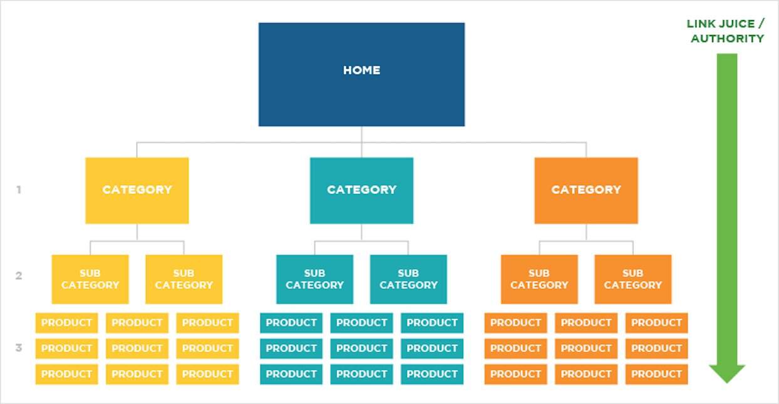
10-foot view – the Webpage
The Importance of Good Site Architecture
The optimal structure for a website would look like a pyramid
Be hyper-relevant to a specific topic
Include subject in title tag
Include subject in URL
Include subject in image alt text
Specify subject several times throughout text content
Provide unique content about a given subject
Link back to its category page
Link back to its subcategory page
Link back to its homepage

Slide 8
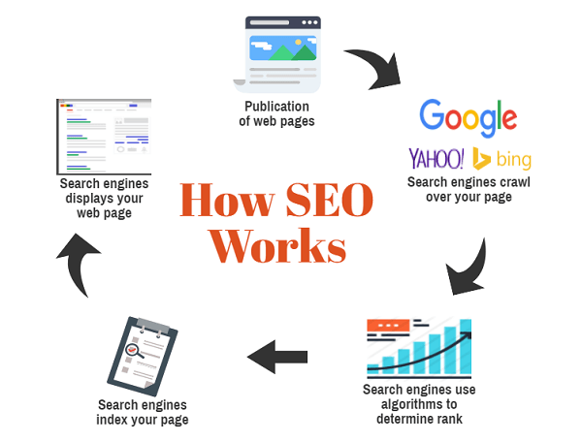
1 foot view – Individual Content Pieces
The content is the single most important element on the website.
The best content is that which does the best job of supplying the largest demand. It might take the form of an XKCD comic that is supplying nerd jokes to a large group of technologists who want to laugh. It also might be a Wikipedia article that explains to the world the definition of Web 2.0. It can be a video, an image, sound, or text, but it must satisfy a demand in order to be considered good content.
From an SEO perspective, there is no difference between the best and worst content on the Net if it is not linkable. If people can’t link to it, search engines will be very unlikely to rank it, and the content won’t drive traffic to the given website.

Slide 9
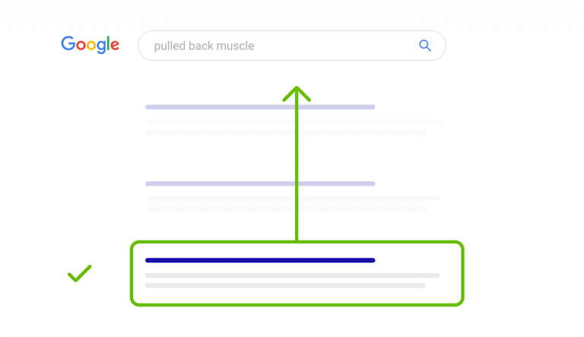
Best Practices
SEO best practices are a set of tasks designed to help improve a website’s search engine rankings. Common search engine optimization best practices include on-site optimization, researching keywords, and building backlinks to a site.

Slide 10
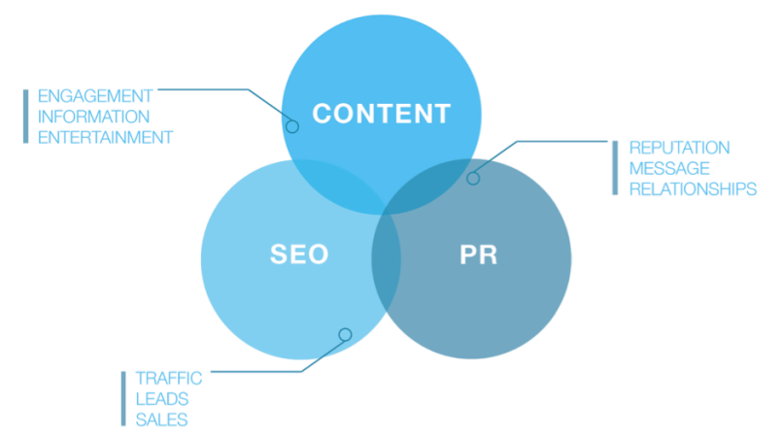
Pros
Improved traffic – You get a great ranking to help attract potential visitors to your website.
Improved web presence – Not just in organic searches but also in different applications.
Target visitors – Instead of getting a lot of general traffic that has little interest in your services or products.
Greater internet presence – A good SEO strategy can ensure that your website is seen by more people. They may not come immediately to your website.
Better conversion rate – Good SEO habits help design your website so that your visitors have an easier time navigating and getting the information they want. This helps turn visitors into customers.

Slide 11

Cons
Results are not instantaneous – You need patience and wait for the SEO to take effect. Search engine ranking and indexing can take anywhere from hours to weeks to do.
RPIs are not quick either – Returns on investments do not show up the next day.
SEO work can be expensive – It costs to use proper SEO strategies. It may be money you can’t afford to spend.
No guarantees – SEO is not a magic wand that will bring your customer son demand. You may not see any results.
Rankings are lost – This may be due to changes in search engine and algorithm changes.
Competition – Your competition may be smarter than you and a lot more aggressive.

